Slide 1
CMP329: Algorithm and Complexity Analysis (3 units) Lecture 5: Divide and Conquer
Mr. M. Yusuf

Slide 2
Outline
Mergesort
Master Theorem
Quicksort
Hoare Partition
Binary Tree Traversals Related Properties
Binary Tree Traversal

Slide 3
What is Divide and Conquer (DnC)?
DnC is probably the best-known general algorithm design technique.
Thus, not every DnC algorithm is necessarily more efﬁcient than even a brute-force solution.
The time spent on executing the DnC plan turns out to be signiﬁcantly smaller than solving a problem by a different method.
DnC yields some of the most important and efﬁcient algorithms in computer science.
DnC ideally suited for parallel computations, in which each subproblem can be solved simultaneously by its own processor.

Slide 4
How Divide and Conquer Techniques Works
A problem is divided into several subproblems of the same type, ideally of about equal size.
The subproblems are solved (typically recursively, though sometimes a different algorithm is employed, especially when subproblems become small enough).
If necessary, the solutions to the subproblems are combined to get a solution to the original problem.

Slide 5
A Typical Case of Divide-and-conquer technique
Problem of size n
Subproblem 1 of size n/2
Subproblem 2 of size n/2
Solution to subproblem 1
Solution to subproblem 2
Don’t assume always breaks up
into 2, could be > 2 subproblems
Solution to the original probelm

Slide 6
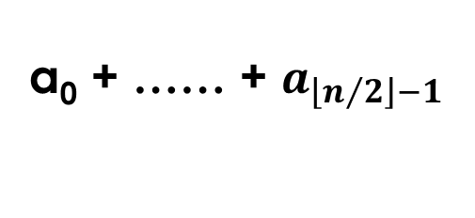
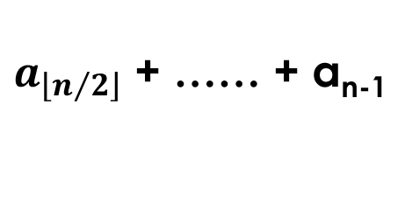
Case Study to Add n Numbers
a₀ + a₁ + …… + a_{n-1}
a₀ + …… + $a_{\left\lfloor n/2\right\rfloor −1}$
$a_{\left\lfloor n/2\right\rfloor }$ + …… + a_{n-1}
Is it more efficient than brute force ?
Let’s see with an example

Slide 7
0 | 1 | 2 | 3 | 4 | 5 | 6 | 7 | 8 | 9
2 | 10 | 3 | 5 | 7 | 1 | 6 | 10 | 1 | 3
0 | 1 | 2 | 3 | 4
0 | 1 | 2 | 3 | 4
2 | 10 | 3 | 5 | 7
1 | 6 | 10 | 1 | 3
2 | 10
3 | 5 | 7
1 | 6
10 | 1 | 3
12
3
5 | 7
7
10
1 | 3
12
4
15
14
27
21
48
# of additions is same as in brute force, needs stack for recursion…
Bad! not all divide
and conquer works!!

Slide 8
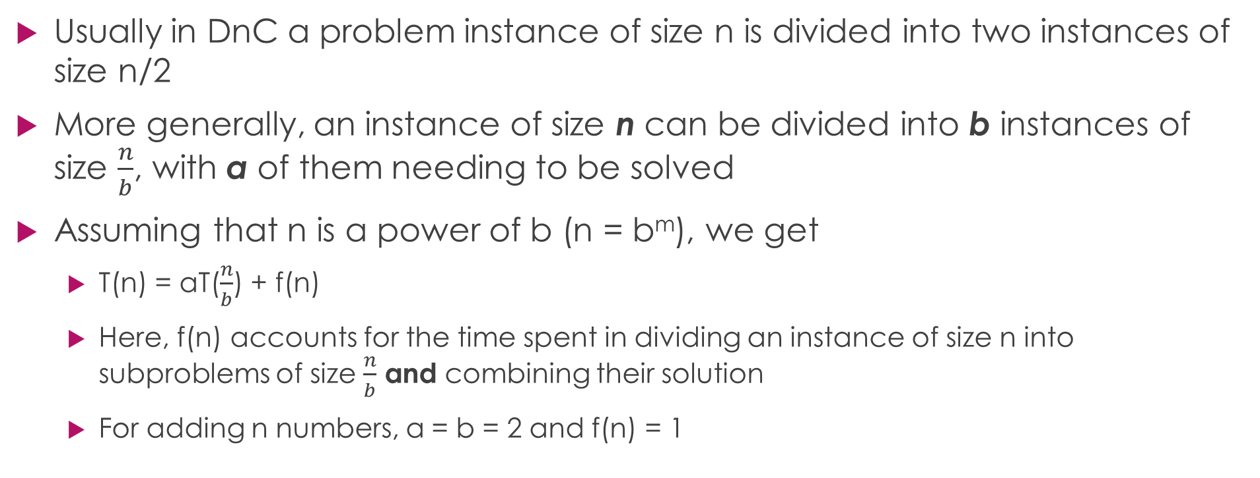
Using Divide-and-Conquer Recurrence Relation
Usually in DnC a problem instance of size n is divided into two instances of size n/2
More generally, an instance of size n can be divided into b instances of size $\frac{n}{b}$, with a of them needing to be solved
Assuming that n is a power of b (n = b^{m}), we get
T(n) = aT($\frac{n}{b}$) + f(n)
Here, f(n) accounts for the time spent in dividing an instance of size n into subproblems of size $\frac{n}{b}$ and combining their solution
For adding n numbers, a = b = 2 and f(n) = 1
This the general DnC recurrence Relation

Slide 9
Outline
Mergesort
Master Theorem
Quicksort
Hoare Partition
Binary Tree Traversals Related Properties
Binary Tree Traversal

Slide 10
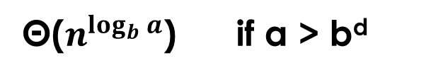
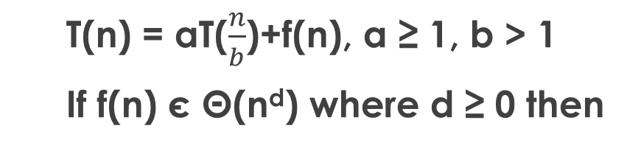
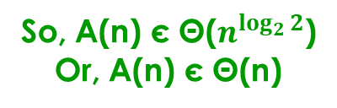
Master Theorem
T(n) = aT($\frac{n}{b}$)+f(n), a ≥ 1, b > 1
If f(n) є Θ(n^{d}) where d ≥ 0 then
Θ(n^{d}) if a < b^{d}
T(n) є
Θ(n^{d}logn) if a = b^{d}
Θ($n^{\log_{b}{a}}$) if a > b^{d}
For adding n numbers with divide and conquer technique,
the number of additions A(n) is:
A(n) = 2A(n/2)+1
Here, a = ?, b = ?, d = ?
a = 2, b = 2, d = 0
Which of the 3 cases holds ?
a = 2 > b^{d} = 2⁰, case 3
So, A(n) є Θ($n^{\log_{2}{2}}$)
Or, A(n) є Θ(n)

Slide 11

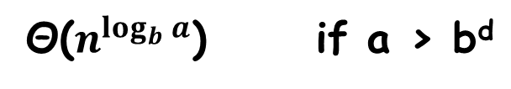


Master Theorem: Example
Θ(n^{d}) if a < b^{d}
T(n) = aT(n/b)+f(n), a ≥ 1, b > 1
If f(n) є Θ(n^{d}) where d ≥ 0, then
T(n) є
Θ(n^{d}lgn) if a = b^{d}
T(n) = 2T(n/2)+6n-1?
Θ($n^{\log_{b}{a}}$) if a > b^{d}
T(n) = 3 T(n/2) + n
a = 3, b = 2, f(n) є Θ(n¹), so d = 1
a=3 > b^{d}=2¹
Case 3: T(n) є Θ( $n^{\log_{2}{3}}$ ) = Θ( $n^{1.5850}$ )
T(n) = 3 T(n/2) + n²
a = 3, b = 2, f(n) є Θ(n²), so d = 2
a=3 < b^{d}=2²
Case 1: T(n) є Θ( $n^{2}$ )
T(n) = 4 T(n/2) + n²
a = 4, b = 2, f(n) є Θ(n²), so d = 2
a=4 = b^{d}=2²
Case 2: T(n) є Θ( $n^{2}$lgn )
T(n) = 0.5 T(n/2) + 1/n
Master th^{m} doesn’t apply,a<1, d<0
T(n) = 2 T(n/2) + n/lgn
Master th^{m} doesn’t apply f(n) not polynomial
T(n) = 64 T(n/8) – n²lgn
f(n) is not positive, doesn’t apply
T(n) = 2^{n} T(n/8) + n
a is not constant, doesn’t apply

Slide 12

First Snippet of Mergesort Algorithm
ALGORITHM Mergesort(A[0..n-1])
//sorts array A[0..n-1] by recursive mergesort
//Input: A[0..n-1] to be sorted
//Output: Sorted A[0..n-1]
if n > 1
copy A[0..$\left\lfloor n/2\right\rfloor$-1] to B[0.. $\left\lfloor n/2\right\rfloor$-1]
copy A[$\left\lfloor n/2\right\rfloor$..n-1] to C[0..$\left\lceil n/2\right\rceil$-1]
Mergesort(B[0..$\left\lfloor n/2\right\rfloor$-1])
Mergesort(C[0..$\left\lceil n/2\right\rceil$-1])
Merge(B, C, A)
B:
2 | 3 | 8 | 9
C:
1 | 4 | 5 | 7
A:
1
2
3
4
5
7
8
9

Slide 13
Second Snippet of Mergesort Algorithm
ALGORITHM Merge(B[0..p-1], C[0..q-1], A[0..p+q-1])
//Merges two sorted arrays into one sorted array
//Input: Arrays B[0..p-1] and C[0..q-1] both sorted
//Output: Sorted array A[0..p+q-1] of elements of B and C
i <- 0; j <- 0; k <- 0;
while i < p and j < q do
if B[i] ≤ C[j]
A[k] <- B[i]; i <- i+1
else
A[k] <- C[j]; j <- j+1
k <- k+1
if i = p
copy C[j..q-1] to A[k..p+q-1]
else
copy B[i..p-1] to A[k..p+q-1]

Slide 14
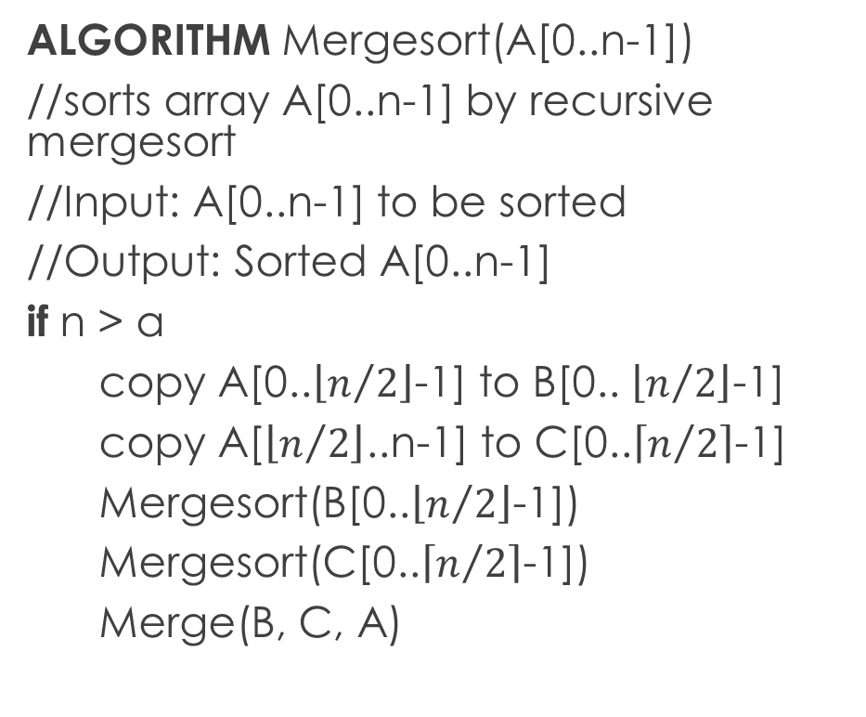
Mergesort Algorithm Comparison…
ALGORITHM Mergesort(A[0..n-1])
//sorts array A[0..n-1] by recursive mergesort
//Input: A[0..n-1] to be sorted
//Output: Sorted A[0..n-1]
if n > a
copy A[0..$\left\lfloor n/2\right\rfloor$-1] to B[0.. $\left\lfloor n/2\right\rfloor$-1]
copy A[$\left\lfloor n/2\right\rfloor$..n-1] to C[0..$\left\lceil n/2\right\rceil$-1]
Mergesort(B[0..$\left\lfloor n/2\right\rfloor$-1])
Mergesort(C[0..$\left\lceil n/2\right\rceil$-1])
Merge(B, C, A)
ALGORITHM Merge(B[0..p-1], C[0..q-1], A[0..p+q-1])
//Merges two sorted arrays into one sorted array //Input: Arrays B[0..p-1] and C[0..q-1] both sorted //Output: Sorted array A[0..p+q-1] of elements of B //and C
i <- 0; j <- 0; k <- 0;
while i < p and j < q do
if B[i] ≤ C[j]
A[k] <- B[i]; i <- i+1
else
A[k] <- C[j]; j <- j+1
k <- k+1
if i = p
copy C[j..q-1] to A[k..p+q-1]
else
copy B[i..p-1] to A[k..p+q-1]

Slide 15
Merge Sort Algorithm: Example
Divide:
Merge:
8 | 3 | 2 | 9 | 7 | 1 | 5 | 4
8 | 3 | 2 | 9
7 | 1 | 5 | 4
8 | 3
2 | 9
7 | 1
5 | 4
8
3
2
9
7
1
5
4
3 | 8
2 | 9
1 | 7
4 | 5
2 | 3 | 8 | 9
1 | 4 | 5 | 7
1 | 2 | 3 | 4 | 5 | 7 | 8 | 9

Slide 16
Summary of Mergesort Algorithm
Worst-case of Mergesort is Θ(nlogn)
Average-case is also Θ(nlogn)
It is stable but quicksort and heapsort are not
Possible improvements
Implement bottom-up. Merge pairs of elements, merge the sorted pairs, so on… (does not require recursion-stack anymore)
Could divide into more than two parts, particularly useful for sorting large files that cannot be loaded into main memory at once: this version is called “multiway mergesort”
Not in-place, needs linear amount of extra memory
Though we could make it in-place, adds a bit more “complexity” to the algorithm

Slide 17
Exercise
Attempt question 1, 2 and 6 of exercise 5.1 on page 174

Slide 18
Outline
Mergesort
Master Theorem
Quicksort
Hoare Partition
Binary Tree Traversals Related Properties
Binary Tree Traversal

Slide 19
Quicksort Algorithm
A divide and conquer based sorting algorithm, discovered by C. A. R. Hoare (British) in 1960 while trying to sort words for a machine translation project from Russian to English
Instead of “Merge” in Mergesort, Quicksort uses the idea of partitioning which we already have seen with “Lomuto Partition”
In Mergesort all work is in combining the partial solutions.
In Quicksort all work is in dividing the problem, Combining does not require much work!

Slide 20
How to Quicksort
A[0]…A[n-1]
A[0]…A[s-1] A[s] A[s+1]…A[n-1]
all are ≤ A[s]
all are ≥ A[s]
A[s] is in it’s
final position
Now continue working with
these two parts

Slide 21
Quicksort Algorithm…
ALGORITHM Quicksort(A[l..r])
//Sorts a subarray by quicksort
//Input: Subarray of A[0..n-1] defined by its
//left and right indices l and r
//Output: Subarray A[l..r] sorted in nondecreasing
//order
if l < r
s <- Partition( A[l..r] ) // s is a split position
Quicksort( A[l..s-1] )
Quicksort( A[s+1]..r )
As a partition algorithm we could use “Lomuto Partition”
But we shall use the more sophisticated “Hoare Partition” instead
We can replace the partition part with any partitioning algorithm like Lomuto Partition or Hoare Partition

Slide 22
Outline
Mergesort
Master Theorem
Quicksort
Hoare Partition
Binary Tree Traversals Related Properties
Binary Tree Traversal

Slide 23
Quicksort Algorithm: Hoare Partitioning
ALGORITHM HoarePartition(A[l..r])
//Output: the split position
p <- A[l]
i <- l; j <- r+1
repeat
repeat i <- i+1 until A[i] ≥ p
repeat j <- j-1 until A[j] ≤ p
swap( A[i], A[j] )
until i ≥ j
swap( A[i], A[j] ) // undo last swap when i ≥ j
swap( A[l], A[j] )
return j
When using “Hoare Partition”
We start by selecting a “pivot”
There are various strategies to select the pivot,
we shall use the simplest:
we shall select pivot, p =A[l], the first element of A[l..r]

Slide 24
How to Sort with Quicksort Algorithm
p
≤ p
p
≥ p
i
j
i
j
p
If A[i] < p, we continue incrementing i, stop when A[i] ≥ p
If A[j] > p, we continue decrementing j, stop when A[j] ≤ p
i
j
p
all ≤ p
≥ p
≤ p
all ≥ p
j
i
p
all ≤ p
≤ p
≥ p
all ≥ p
j=i
p
all ≤ p
= p
all ≥ p

Slide 25
Quicksort Example
If A[j] > p, we continue decrementing j, stop when A[j] ≤ p
i
j
i
j
If A[i] < p, we continue incrementing i, stop when A[i] ≥ p
5 | 3 | 1 | 9 | 8 | 2 | 4 | 7
2 | 3 | 1 | 4 | 5 | 8 | 9 | 7
i
j
i
j
5 | 3 | 1 | 9 | 8 | 2 | 4 | 7
2 | 3 | 1 | 4 | 5 | 8 | 9 | 7
1 | 2 | 3 | 4 | 5 | 8 | 9 | 7
i
j
i
j
j
i
5 | 3 | 1 | 4 | 8 | 2 | 9 | 7
2 | 1 | 3 | 4 | 5 | 8 | 9 | 7
1 | 2 | 3 | 4 | 5 | 8 | 9 | 7
i
j
j
i
i
j
5 | 3 | 1 | 4 | 8 | 2 | 9 | 7
2 | 1 | 3 | 4 | 5 | 8 | 9 | 7
1 | 2 | 3 | 4 | 5 | 8 | 7 | 9
i
j
j
i
5 | 3 | 1 | 4 | 2 | 8 | 9 | 7
1 | 2 | 3 | 4 | 5 | 8 | 9 | 7
1 | 2 | 3 | 4 | 5 | 8 | 7 | 9
j
i
5 | 3 | 1 | 4 | 2 | 8 | 9 | 7
1 | 2 | 3 | 4 | 5 | 8 | 9 | 7
1 | 2 | 3 | 4 | 5 | 7 | 8 | 9
When ever j and j crosses each other, we swap pivot element with element at j
i=j
2 | 3 | 1 | 4 | 5 | 8 | 9 | 7
1 | 2 | 3 | 4 | 5 | 8 | 9 | 7
1 | 2 | 3 | 4 | 5 | 7 | 8 | 9
j
i
1 | 2 | 3 | 4 | 5 | 8 | 9 | 7
1 | 2 | 3 | 4 | 5 | 7 | 8 | 9

Slide 26
Quicksort Algorithm…
ALGORITHM Quicksort(A[l..r])
if l < r
s <- HoarePartition ( A[l..r] )
Quicksort( A[l..s-1] )
Quicksort( A[s+1]..r )
ALGORITHM HoarePartition(A[l..r])
//Output: the split position
p <- A[l]
i <- l; j <- r+1
repeat
repeat i <- i+1 until A[i] ≥ p
repeat j <- j-1 until A[j] ≤ p
swap( A[i], A[j] )
until i ≥ j
swap( A[i], A[j] ) // undo last swap when i ≥ j
swap( A[l], A[j] )
return j

Slide 27
Quicksort Operation
0 | 1 | 2 | 3 | 4 | 5 | 6 | 7
0 | 1 | 2 | 3 | 4 | 5 | 6 | 7
5 | 3 | 1 | 9 | 8 | 2 | 4 | 7
5 | 3 | 1 | 9 | 8 | 2 | 4 | 7
0 | 1 | 2 | 3 | 4 | 5 | 6 | 7
If all splits happen in the
middle, it is the best-case!
l=0,r=7
2 | 3 | 1 | 4 | 5 | 8 | 9 | 7
s=4
0 | 1 | 2 | 3
5 | 6 | 7
(a)
l=0,r=3
l=5,r=7
s=1
s=6
1 | 2 | 3 | 4
7 | 8 | 9
(b)
l=0,r=0
l=2,r=3
l=5,r=5
l=7,r=7
0
5
s=2
1
7
l=2,r=1
l=3,r=3
2 | 3
7
3 | 4
9
3
4
(a) Array’s transformations with pivots shown in bold.
(b) Tree of recursive calls to Quicksort with input values l and r of subarray bounds and split position s of a partition obtained.

Slide 28
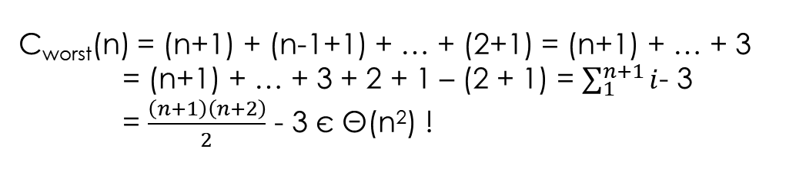

Solving Quicksort with Master Theorem
T(n) = aT(n/b)+f(n), a ≥ 1, b > 1
If f(n) є n^{d} with d ≥ 0, then
Θ(n^{d}) if a < b^{d}
ALGORITHM Quicksort(A[l..r])
if l < r
s <- Partition( A[l..r] )
Quicksort( A[l..s-1] )
Quicksort( A[s+1]..r )
T(n) є
Θ(n^{d}lgn) if a = b^{d}
Θ($n^{\log_{b}{a}}$) if a > b^{d}
C_{worst}(n) = (n+1) + (n-1+1) + … + (2+1) = (n+1) + … + 3
= (n+1) + … + 3 + 2 + 1 – (2 + 1) = $\sum_{1}^{n+1}{i}$- 3
= $\frac{\left(n+1\right)\left(n+2\right)}{2}$ - 3 є Θ(n²) !
So, Quicksort’s fate
depends on its average-case!

Slide 29
How can we Improve the Performance of Quicksort Algorithm
Recall that for Quicksort, C_{best}(n) ≈ nlgn
Quicksort is usually faster than Mergesort or Heapsort on randomly ordered arrays of nontrivial sizes
Some possible improvements
Randomized quicksort: selects a random element as pivot
Median-of-three: selects median of left-most, middle, and right-most elements as pivot
Switching to insertion sort on very small subarrays, or not sorting small subarrays at all and finish the algorithm with insertion sort applied to the entire nearly sorted array
Modify partitioning: three-way partition
These improvements can speed up by 20% to 30%
Weaknesses - Not Stable

Slide 30
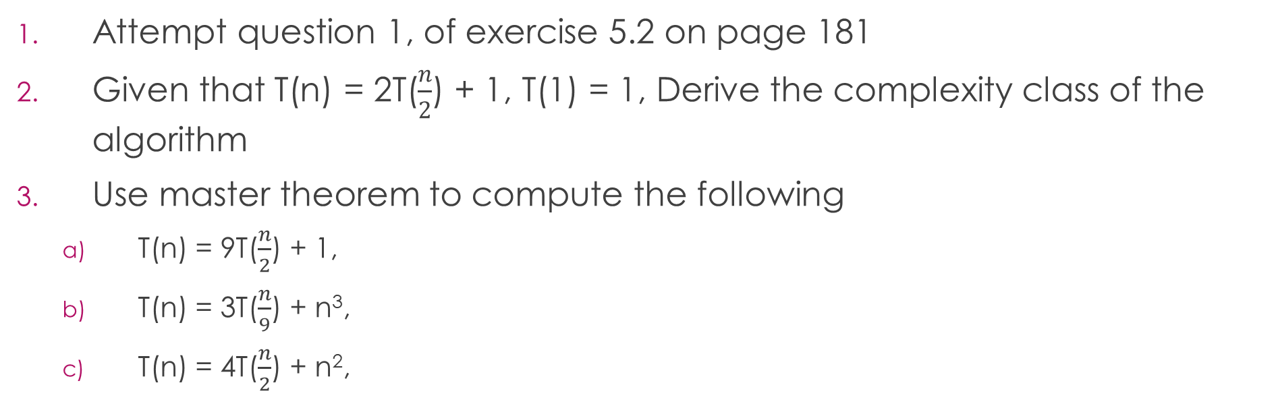
Exercise
Attempt question 1, of exercise 5.2 on page 181
Given that T(n) = 2T($\frac{n}{2}$) + 1, T(1) = 1, Derive the complexity class of the algorithm
Use master theorem to compute the following
T(n) = 9T($\frac{n}{2}$) + 1,
T(n) = 3T($\frac{n}{9}$) + n³,
T(n) = 4T($\frac{n}{2}$) + n²,

Slide 31
Outline
Mergesort
Master Theorem
Quicksort
Hoare Partition
Binary Tree Traversals Related Properties
Binary Tree Traversal

Slide 32
Binary Tree Traversals and Related Properties
We discuss how the divide-and-conquer technique can be applied to binary trees.
A binary tree T is deﬁned as a ﬁnite set of nodes that is either empty or consists of a root and two disjoint binary trees T_{L} and T_{R} called, respectively, the left and right subtree of the root.
Root
T_{L}
T_{R}

Slide 33
Binary Search Tree
ALGORITHM Height(T)
//Compute recursively the height of a binary tree
//Input: A binary tree T
//Output: The height of tree T
If T = 0
return -1
else
return max{height(T_{left}), Height(T_{right})} + 1

Slide 34
Divide and Conquer: Binary Search Tree
The most important divide-and-conquer algorithms for binary trees are the three classic traversals namely;
the preorder traversal, the root is visited before the left and right subtrees are visited
the inorder traversal, the root is visited after visiting its left subtree but before visiting the right subtree.
the postorder traversal, the root is visited after visiting the left and right subtrees.

Slide 35
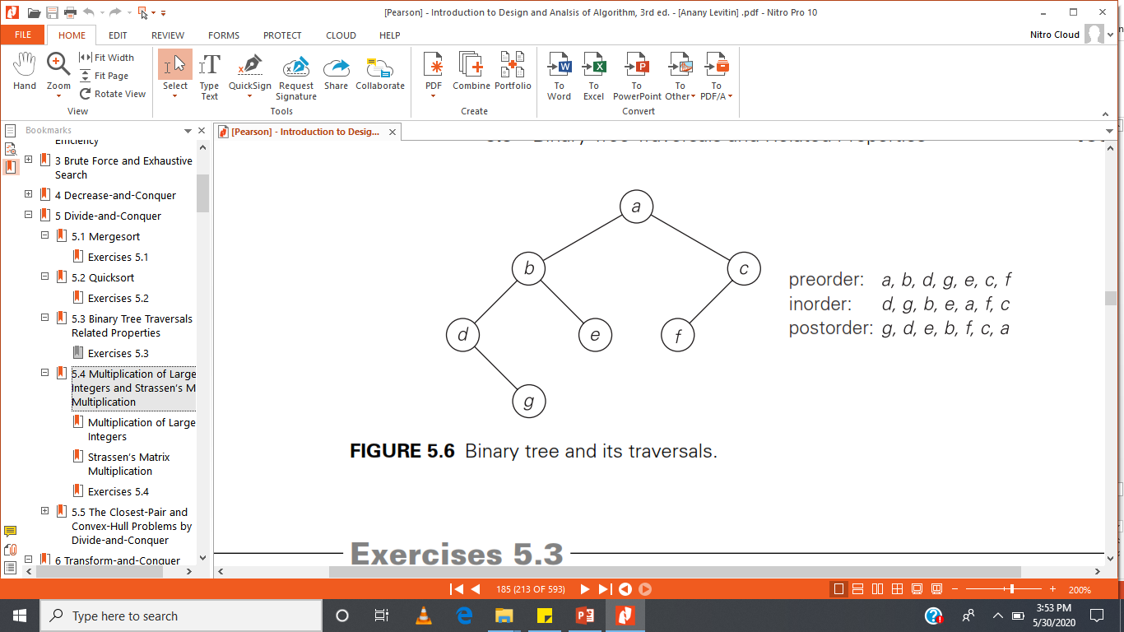
Binary Tree Traversal: Example

Slide 36
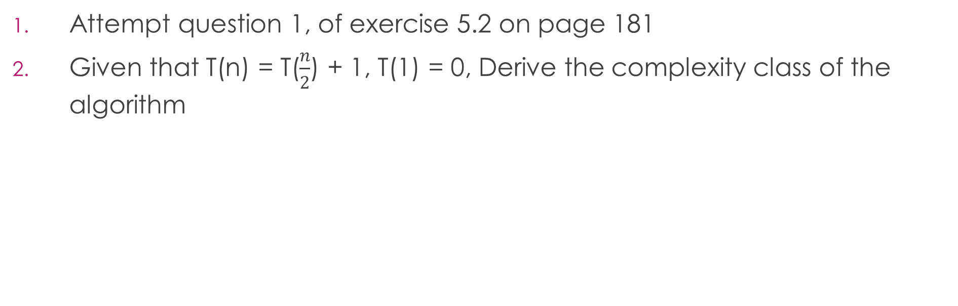
Exercise
Attempt question 1, of exercise 5.2 on page 181
Given that T(n) = T($\frac{n}{2}$) + 1, T(1) = 0, Derive the complexity class of the algorithm

Slide 37
Thank You

